Slide 1



Sustainability of Rural Tourism Products in South Africa
Univen & CSIR
National Department of Tourism Research Seminar, Johannesburg, South Africa
23 March 2018

Slide 2
Context
South Africa does not have a framework for sustainable rural tourism products.
Frameworks existing elsewhere may not just be borrowed in their current state and format for use in South Africa.

Slide 3
Objectives
To:
to provide a critical review of literature on the RTPs and how they may be assessed in terms of their sustainability,
to identify and profile RTPs in South Africa, and
to develop a framework that acts as a base for RTPs to assess their sustainability, from both a demand and supply perspective.

Slide 4
Conceptualising Rural Tourism

Slide 5
Methodology: Literature Review

Slide 6
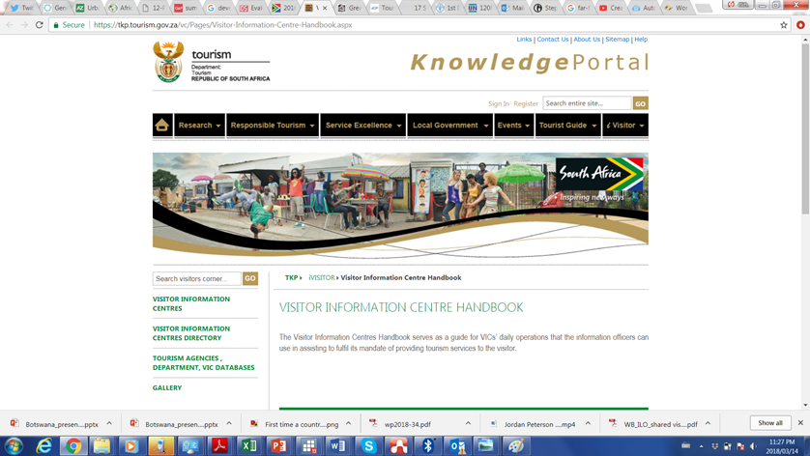

Methodology: Identifying information sources, searching for RTPs

Slide 7
Methodology: Key Informant Interviews

Slide 8
Methodology: Developing principles, criteria and indicators to assess sustainability of RTPs in South Africa

Slide 9
Methodology: Piloting and Case Selection to Empirically Test the RTP Sustainability Framework
One RTP identified for piloting
Three RTPs, identified as cases
One positive response with no response on applying the framework
Three delayed responses

Slide 10
Results: From Reviewed Literature - RTP

Slide 11
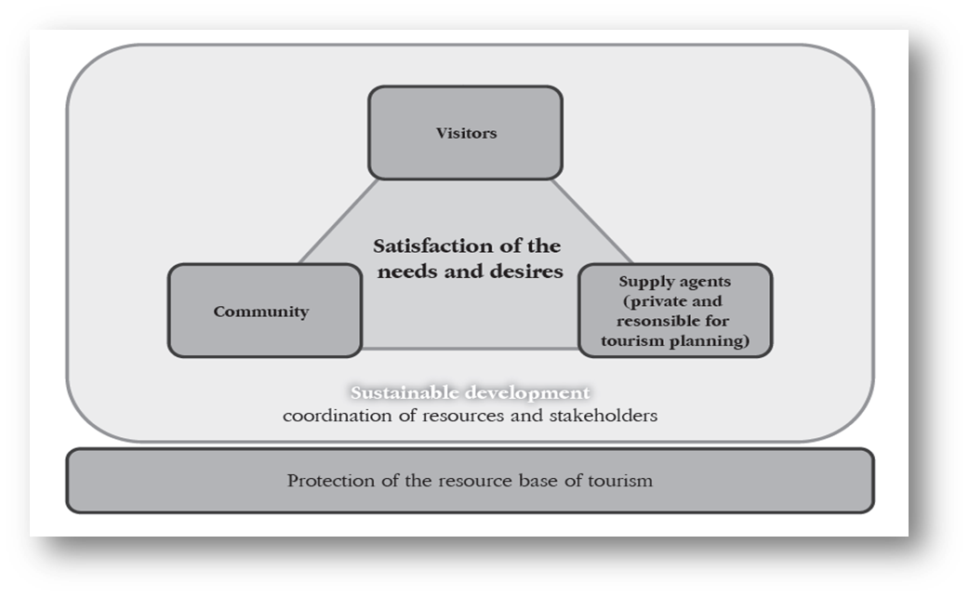
Results: From Reviewed Literature - Sustainability

Slide 12
Results: From Key Informants

Slide 13
Results: From Internet Search of RTPs - Profiling

Slide 14
Results: From Internet Search of RTPs - Profiling

Slide 15
Results: From Internet Search of RTPs - Profiling

Slide 16
Results: Sustainability framework

Slide 17
Results: Sustainability framework

Slide 18
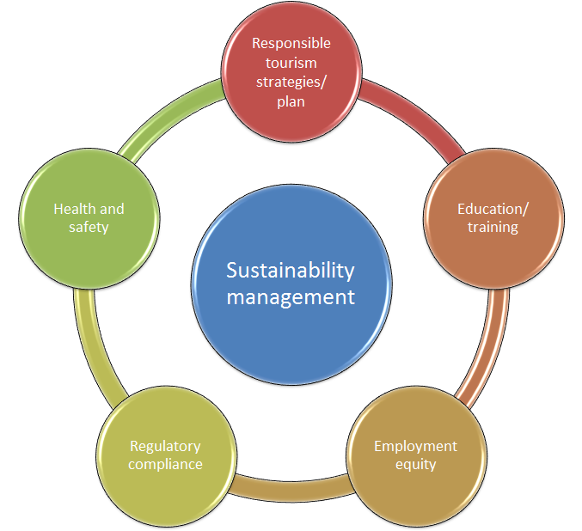
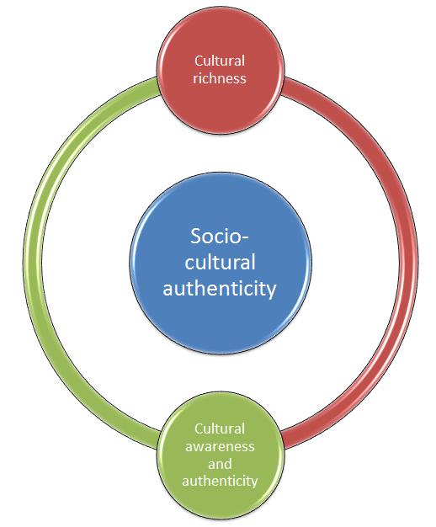
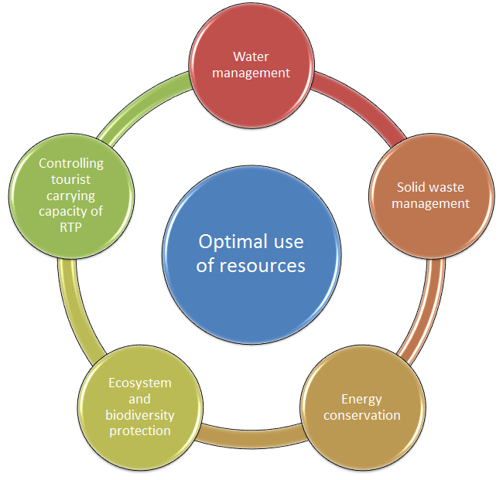
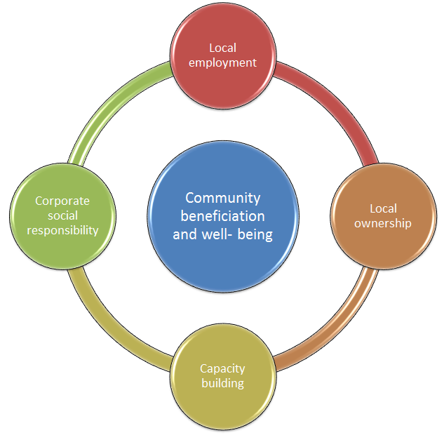
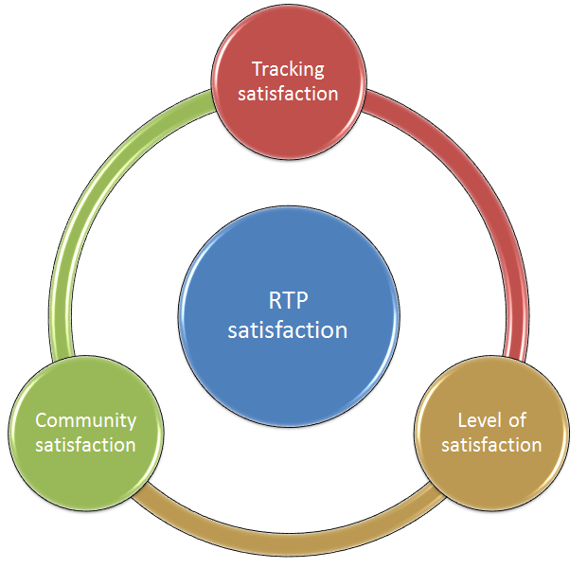
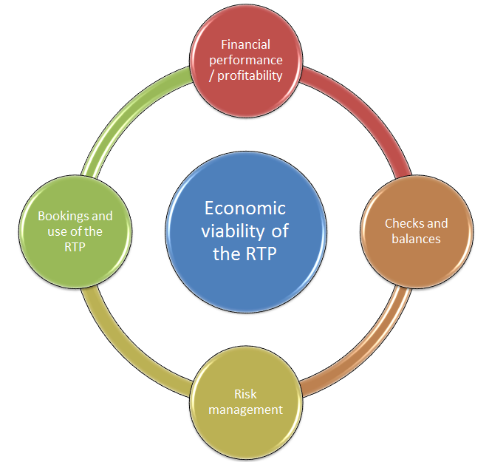
SUSTAINABILITY
FRAMEWORK
PRINCIPLES

Slide 19
RTP Sustainability hypothetical application

Slide 20
RTP Sustainability hypothetical application

Slide 21
Selection of Indicators

Slide 22
Thank you

